Slide 1
Organic Molecules Tutorial
Functional Groups
Dr. Ron Rusay

Slide 2
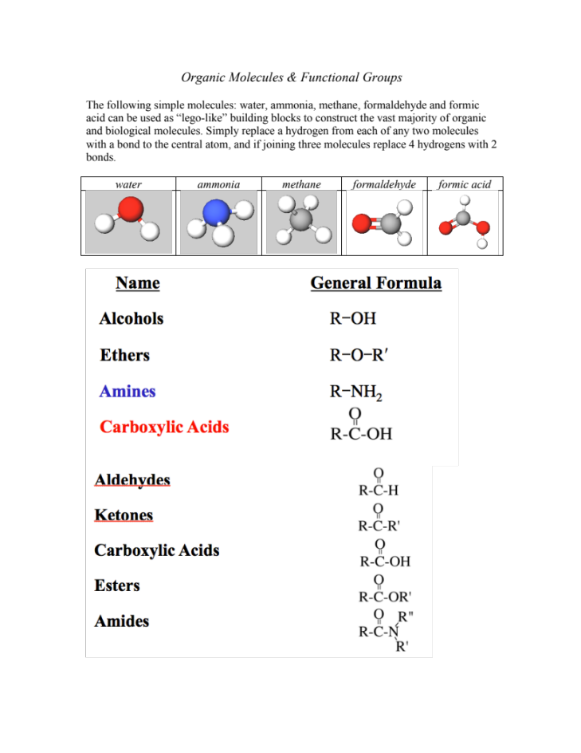
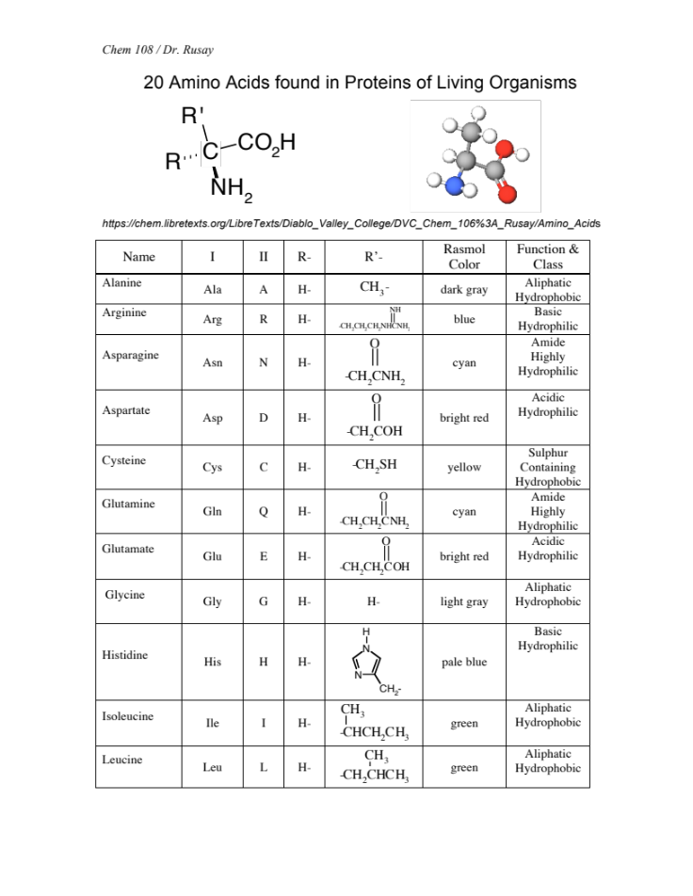
Functional Groups & Amino Acids

Slide 3
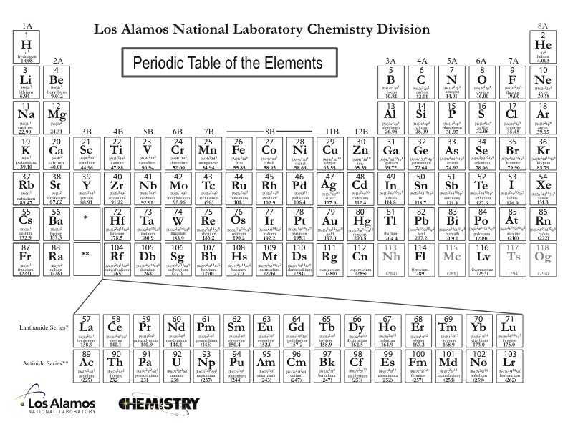
Elemental building blocks for all organic molecules
Notes:
Discipline-Based Education Research: Understanding and
Improving Learning in Undergraduate Science and Engineering
Susan R. Singer, Natalie R. Nielsen, and Heidi A. Schweingruber, Editors
ISBN 978-0-309-25411-3 | DOI 10.17226/13362 2012
Effective instruction involves a range of
approaches, including making lectures more interactive, having students
work in groups, and incorporating authentic problems and activities.
Students who go on to have successful careers in science or engineering
must be problem solvers, skilled in quantitative reasoning and modeling,
effective at communication and cross-disciplinary collaboration, and cognizant
of relationships between science and society (Brewer and Smith,
2011). Students who do not pursue these careers need to understand science
and engineering to serve in their roles as citizens, consumers, and leaders
of business and government who need to make wise science-informed
decisions in their personal and professional lives. Choosing healthcare for
one’s children, buying a car, voting about land-use regulations, or retrofitting
one’s house or business to be more earthquake-resistant are but a few
of the decisions that today’s undergraduates may face. Their decisions on
these and other issues will be based, in part, on their confidence in the
methods of science and engineering and their understanding of the findings
of science and engineering.
The importance of science and engineering in preparing the technical
workforce and a science-literate citizenry has drawn increased attention to
the quality of undergraduate science and engineering education and how it
can be improved. There are persistent concerns that undergraduate science
and engineering courses are not providing students with high-quality learning
experiences, nor are they attracting and retaining students in science
and engineering fields (President’s Council of Advisors on Science and Technology,
2012). Colleges and universities also face the challenge of serving
an increasingly socially, economically, and ethnically diverse undergraduate
population entering college classrooms directly from high school, after a
military career or other life experiences, or from postsecondary educational
experiences at another institution. Sustained attention to motivating, engaging
and supporting the learning of all students who enter college science
and engineering classrooms is an imperative.

Slide 4
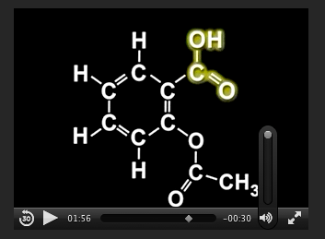
Synthesis of a Non-steroid anti-inflammatory drug
Aspirin
http://chemconnections.org/general/movies/Representations.MOV
Notes:
Discipline-Based Education Research: Understanding and
Improving Learning in Undergraduate Science and Engineering
Susan R. Singer, Natalie R. Nielsen, and Heidi A. Schweingruber, Editors
ISBN 978-0-309-25411-3 | DOI 10.17226/13362 2012
Effective instruction involves a range of
approaches, including making lectures more interactive, having students
work in groups, and incorporating authentic problems and activities.
Students who go on to have successful careers in science or engineering
must be problem solvers, skilled in quantitative reasoning and modeling,
effective at communication and cross-disciplinary collaboration, and cognizant
of relationships between science and society (Brewer and Smith,
2011). Students who do not pursue these careers need to understand science
and engineering to serve in their roles as citizens, consumers, and leaders
of business and government who need to make wise science-informed
decisions in their personal and professional lives. Choosing healthcare for
one’s children, buying a car, voting about land-use regulations, or retrofitting
one’s house or business to be more earthquake-resistant are but a few
of the decisions that today’s undergraduates may face. Their decisions on
these and other issues will be based, in part, on their confidence in the
methods of science and engineering and their understanding of the findings
of science and engineering.
The importance of science and engineering in preparing the technical
workforce and a science-literate citizenry has drawn increased attention to
the quality of undergraduate science and engineering education and how it
can be improved. There are persistent concerns that undergraduate science
and engineering courses are not providing students with high-quality learning
experiences, nor are they attracting and retaining students in science
and engineering fields (President’s Council of Advisors on Science and Technology,
2012). Colleges and universities also face the challenge of serving
an increasingly socially, economically, and ethnically diverse undergraduate
population entering college classrooms directly from high school, after a
military career or other life experiences, or from postsecondary educational
experiences at another institution. Sustained attention to motivating, engaging
and supporting the learning of all students who enter college science
and engineering classrooms is an imperative.

Slide 5
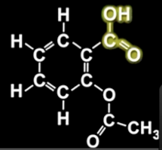
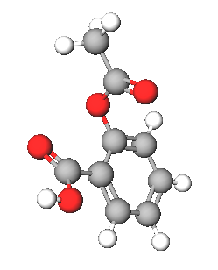
QUESTION
#1
One of aspirin’s functions, an ester, is circled in blue. What is the highlighted yellow function?:
Alcohol
Ether
Ketone
Aldehyde
Carboxylic Acid
http://chemconnections.org/general/chem108/o-chem%20tutorial/Screen%20Shot%202018-12-07%20at%203.49.36%20PM.png
Notes:
Methyl salicylate (oil of wintergreen or wintergreen oil) is an organic ester naturally produced by many species of plants, particularly wintergreens. It is also synthetically produced, used as a fragrance, in foods and beverages, and in liniments.
The compound methyl salicylate was first isolated (from the plant Gaultheria procumbens) in 1843 by the French chemist Auguste André Thomas Cahours (1813–1891), who identified it as an ester of salicylic acid and methanol.[4]
1

Slide 6
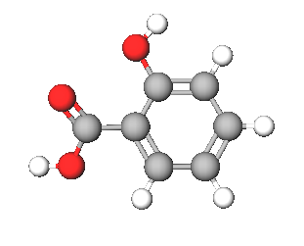
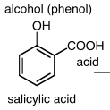
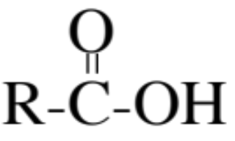
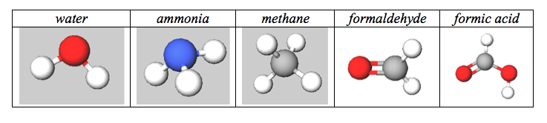
Salicylic Acid
Common Functional Groups
Name General Formula
Alcohols R−ΟΗ
Ethers R−Ο−R′
Amines R−ΝΗ₂
Carboxylic Acids

Slide 7
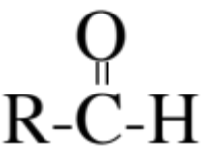
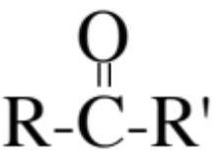
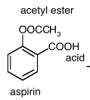
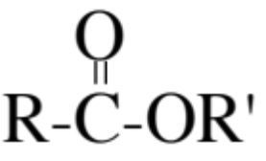
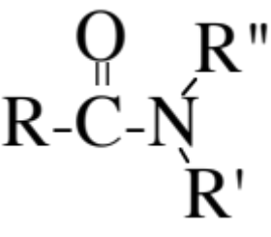
Aspirin
Common Functional Groups
Name General Formula
Aldehydes
Ketones
Carboxylic Acids
Esters
Amides

Slide 8
Shapes, Functions & Structural Analogies
Water, Ammonia, Methane
Plus C=O “carbonyls”
Organic Molecules
Notes:
1

Slide 9
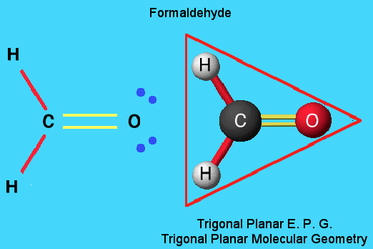
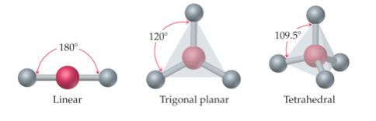
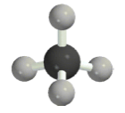
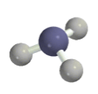
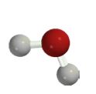
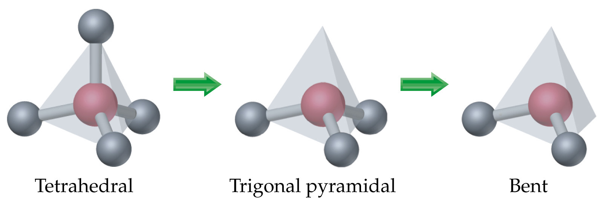
Molecular Models for C, H, N, O
Fundamental repeating shapes found in every biological molecule
C =black
H = gray
N = blue
O = oxygen
pink = generic atom

Slide 10
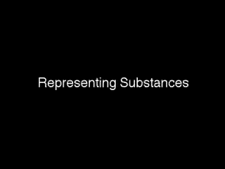
Representing Organic Molecules
http://chemconnections.org/general/movies/Representations.MOV
Notes:
Discipline-Based Education Research: Understanding and
Improving Learning in Undergraduate Science and Engineering
Susan R. Singer, Natalie R. Nielsen, and Heidi A. Schweingruber, Editors
ISBN 978-0-309-25411-3 | DOI 10.17226/13362 2012
Effective instruction involves a range of
approaches, including making lectures more interactive, having students
work in groups, and incorporating authentic problems and activities.
Students who go on to have successful careers in science or engineering
must be problem solvers, skilled in quantitative reasoning and modeling,
effective at communication and cross-disciplinary collaboration, and cognizant
of relationships between science and society (Brewer and Smith,
2011). Students who do not pursue these careers need to understand science
and engineering to serve in their roles as citizens, consumers, and leaders
of business and government who need to make wise science-informed
decisions in their personal and professional lives. Choosing healthcare for
one’s children, buying a car, voting about land-use regulations, or retrofitting
one’s house or business to be more earthquake-resistant are but a few
of the decisions that today’s undergraduates may face. Their decisions on
these and other issues will be based, in part, on their confidence in the
methods of science and engineering and their understanding of the findings
of science and engineering.
The importance of science and engineering in preparing the technical
workforce and a science-literate citizenry has drawn increased attention to
the quality of undergraduate science and engineering education and how it
can be improved. There are persistent concerns that undergraduate science
and engineering courses are not providing students with high-quality learning
experiences, nor are they attracting and retaining students in science
and engineering fields (President’s Council of Advisors on Science and Technology,
2012). Colleges and universities also face the challenge of serving
an increasingly socially, economically, and ethnically diverse undergraduate
population entering college classrooms directly from high school, after a
military career or other life experiences, or from postsecondary educational
experiences at another institution. Sustained attention to motivating, engaging
and supporting the learning of all students who enter college science
and engineering classrooms is an imperative.

Slide 11
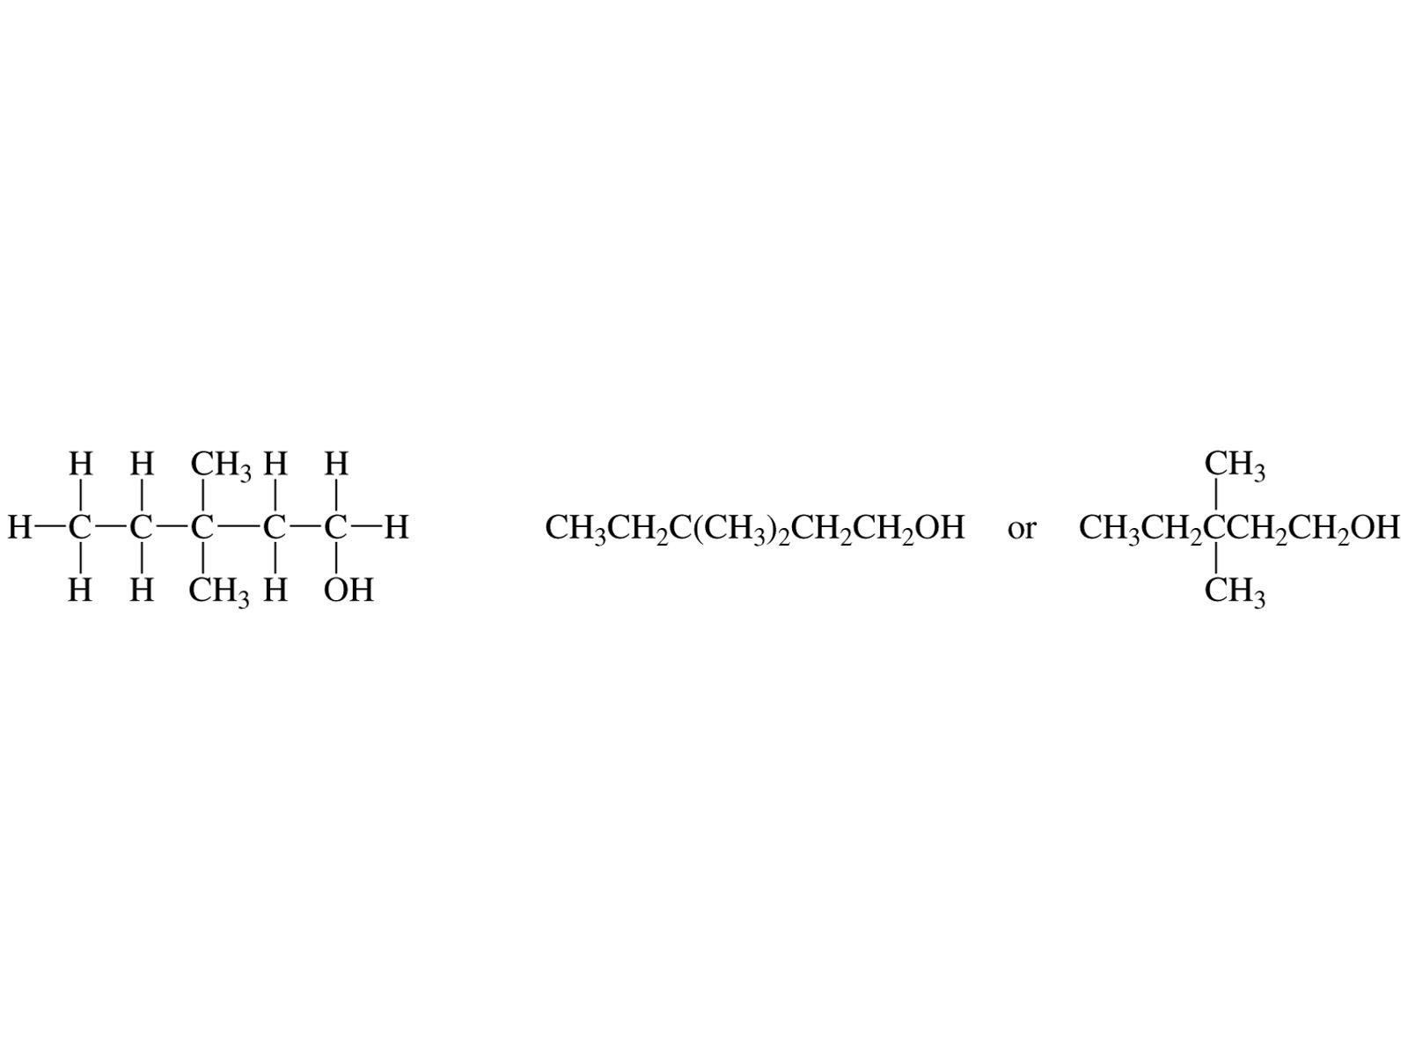
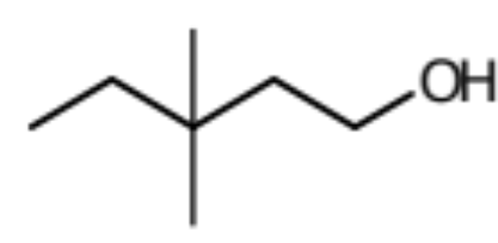
Representing Organic Molecules
Common Formulas & Drawings
Molecular formula:
C₇H₁₆O
Empirical Formula:
C₇H₁₆O
Condensed Structure:
Bond-Line Structure:
Notes:
Figure Number: 01-01-29T05UN
Title: Table 1.5 Groups bonded to the far right carbon.
Caption:
Notes:

Slide 12
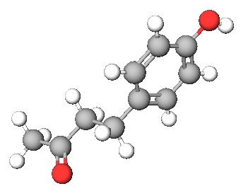
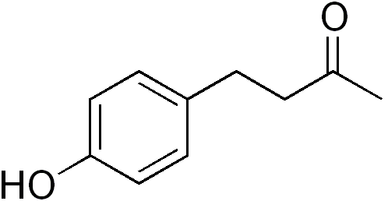

QUESTION
#2
A compound that smells like fresh raspberries, the following structure, C?H?O?, matches its calculated molar mass which is 164 g/mol.
A) TRUE
B) FALSE
http://chemconnections.org/general/chem108/o-chem%20tutorial/Screen%20Shot%202018-12-07%20at%203.50.06%20PM.png

Slide 13
Organic Molecules
Common Functional Groups
Name General Formula
Alcohols R−ΟΗ
Ethers R−Ο−R′
Amines R−ΝΗ₂
Carboxylic Acids
R′− or R− represents any generic carbon atom bonded in the functional group

Slide 14
Organic Molecules
Common Functional Groups
Name General Formula
Aldehydes
Ketones
Carboxylic Acids
Esters
Amides
R′− or R− represents any generic carbon atom bonded in the functional group

Slide 15
QUESTION
#3
Select the function(s) in the molecule
 | Alcohol | R−ΟΗ
 | Ether | R−Ο−R′
 | Amine | R−ΝΗ₂
 | Aldehyde
 | Ketone
 | Carboxylic Acid
 | Ester
 | Amide
http://chemconnections.org/general/chem108/o-chem%20tutorial/Screen%20Shot%202018-12-07%20at%203.54.07%20PM.png

Slide 16
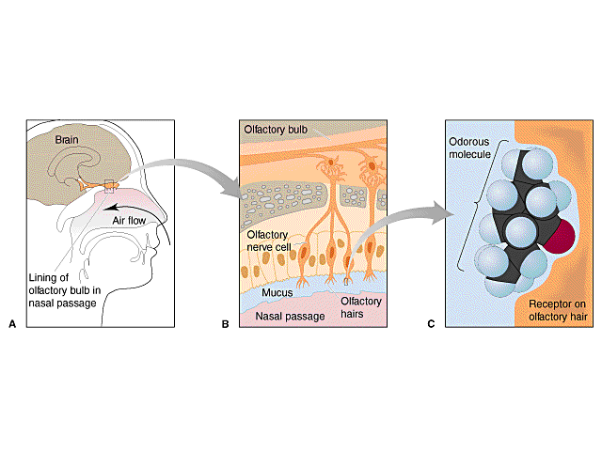

Detecting stuff we cannot see: the Sense of Smell
Models, Theories & Interactions
http://chemconnections.org/organic/chem226/Labs/Smell/smell-links.html
Structure-Odor Relationships
Karen J. Rossiter, Chem. Rev., 1996, 96, 3201-3240

Slide 17
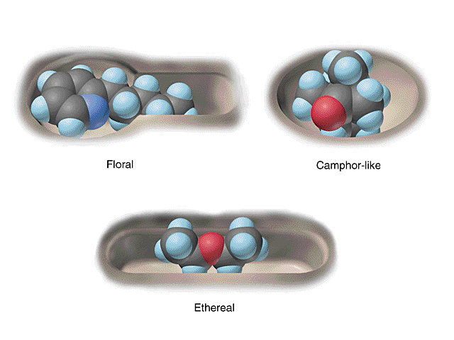
Historical view of a few smell receptors.
4 October 2004
The Nobel Assembly at Karolinska Institutet has today decided to award
The Nobel Prize in Physiology or Medicine for 2004
jointly to
Richard Axel and Linda B. Buck
for their discoveries of
"odorant receptors and the organization of the olfactory system"
http://chemconnections.org/organic/chem226/Labs/Smell/ChemComm.html
Notes:
They discovered a large gene family, comprised of some 1,000 different genes (three per cent of our genes) that give rise to an equivalent number of olfactory receptor types. These receptors are located on the olfactory receptor cells, which occupy a small area in the upper part of the nasal epithelium and detect the inhaled odorant molecules.

Slide 18
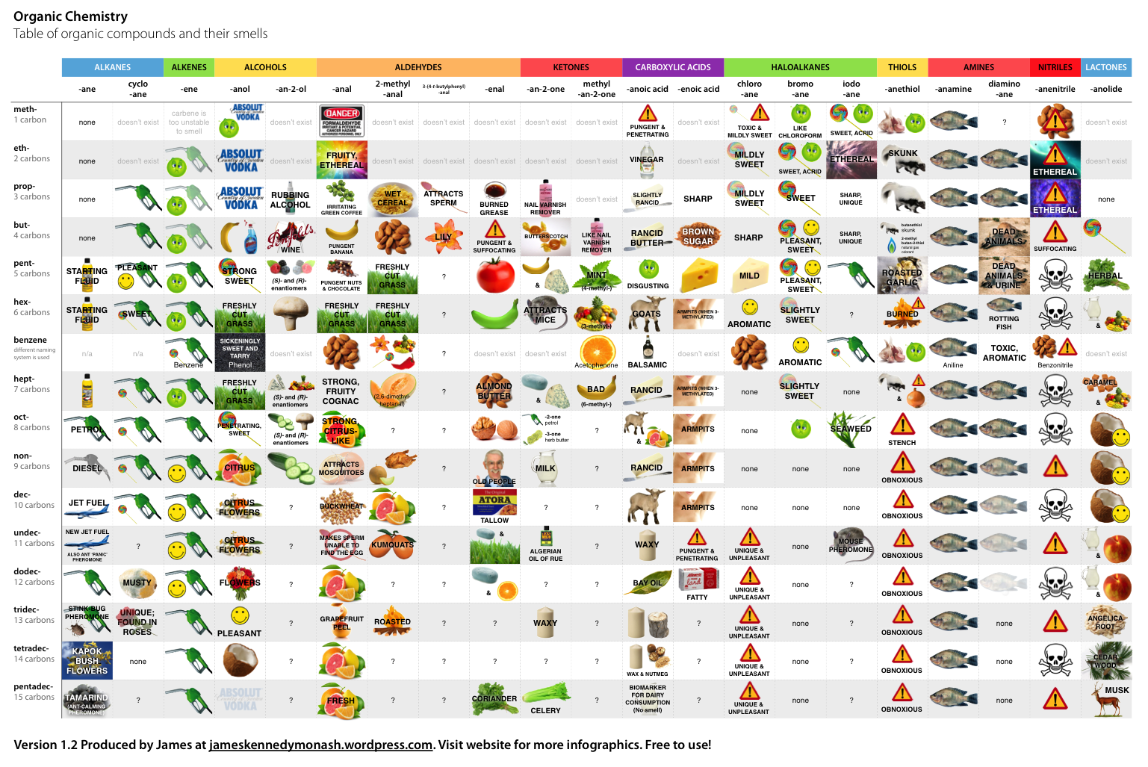
Organic Functions & Smell Receptors.
Notes:
Marcel Proust, was a French novelist, critic, and essayist best known for his monumental novel À la recherche du temps perdu (In Search of Lost Time; earlier rendered as Remembrance of Things Past), published in seven parts between 1913 and 1927. He is considered by critics and writers to be one of the most influential authors of the 20th century.[
1

Slide 19
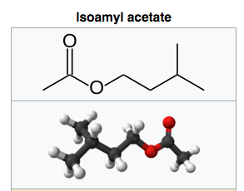
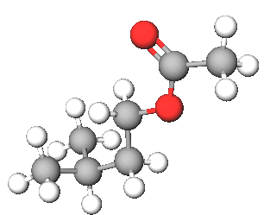
One molecule, one function: One Smell Receptor
Isoamyl acetate, also known as isopentyl acetate, is formed from isoamyl alcohol and acetic acid. It is a colorless liquid that is only slightly soluble in water, but very soluble in most organic solvents. Isoamyl acetate has a strong odor which is also described as similar to both banana and pear.[3] Banana oil may be either pure isoamyl acetate, or flavorings that are mixtures of isoamyl acetate, amyl acetate, and other flavors.
C₇H₁₄O₂
Notes:
Marcel Proust, was a French novelist, critic, and essayist best known for his monumental novel À la recherche du temps perdu (In Search of Lost Time; earlier rendered as Remembrance of Things Past), published in seven parts between 1913 and 1927. He is considered by critics and writers to be one of the most influential authors of the 20th century.[
1

Slide 20
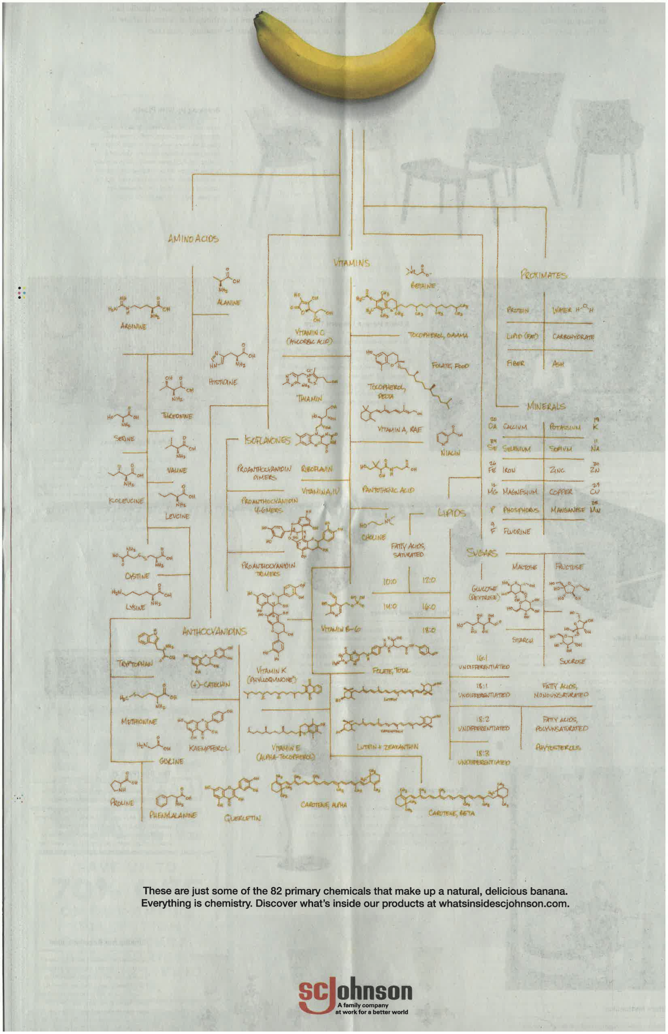
One molecule among 82 primary chemicals found in bananas:
C₇H₁₄O₂
Notes:
Marcel Proust, was a French novelist, critic, and essayist best known for his monumental novel À la recherche du temps perdu (In Search of Lost Time; earlier rendered as Remembrance of Things Past), published in seven parts between 1913 and 1927. He is considered by critics and writers to be one of the most influential authors of the 20th century.[
1

Slide 21
QUESTION
#4
C₇H₁₄O₂
The function in isoamyl acetate’s structure is a(n):
Alcohol
Aldehyde
Ketone
Ester
Carboxylic Acid
http://chemconnections.org/general/chem108/o-chem%20tutorial/Screen%20Shot%202018-12-07%20at%203.54.35%20PM.png
Notes:
Marcel Proust, was a French novelist, critic, and essayist best known for his monumental novel À la recherche du temps perdu (In Search of Lost Time; earlier rendered as Remembrance of Things Past), published in seven parts between 1913 and 1927. He is considered by critics and writers to be one of the most influential authors of the 20th century.[
1

Slide 22
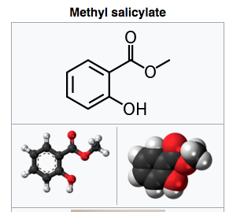
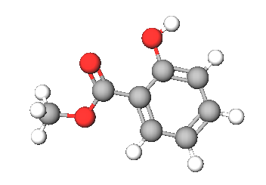
One molecule, two functions: One Smell Receptor
Methyl salicylate (oil of wintergreen or wintergreen oil) is naturally produced by many species of plants, particularly wintergreens. It is also synthetically produced, used as a fragrance, in foods and beverages, and in liniments.
C₈H₈O₃
Notes:
Methyl salicylate (oil of wintergreen or wintergreen oil) is an organic ester naturally produced by many species of plants, particularly wintergreens. It is also synthetically produced, used as a fragrance, in foods and beverages, and in liniments.
The compound methyl salicylate was first isolated (from the plant Gaultheria procumbens) in 1843 by the French chemist Auguste André Thomas Cahours (1813–1891), who identified it as an ester of salicylic acid and methanol.[4]
1

Slide 23
QUESTION
#5
C₈H₈O₃
One of the functions, an ester, is circled. What is the other function?:
Alcohol
Ether
Ketone
Aldehyde
Carboxylic Acid
http://chemconnections.org/general/chem108/o-chem%20tutorial/Screen%20Shot%202018-12-07%20at%203.54.53%20PM.png
Notes:
Methyl salicylate (oil of wintergreen or wintergreen oil) is an organic ester naturally produced by many species of plants, particularly wintergreens. It is also synthetically produced, used as a fragrance, in foods and beverages, and in liniments.
The compound methyl salicylate was first isolated (from the plant Gaultheria procumbens) in 1843 by the French chemist Auguste André Thomas Cahours (1813–1891), who identified it as an ester of salicylic acid and methanol.[4]
1

Slide 24
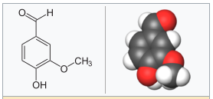
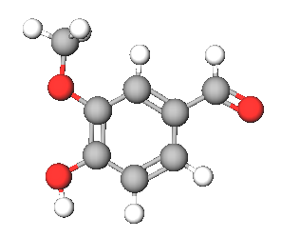
One molecule, three functions: One Smell Receptor
Vanillin
An extract of the cured, full-grown, unripe fruit of an orchid produces a popular flavoring. The natural extract sells for ~ $1500/kg versus ~ $20/kg for the synthetic version. The structure of the compound that is responsible for the smell/flavor is shown to the right. The Guinness Book of World Records once listed this compound as having the lowest smell detection limit of all chemicals (2 x 10 ^{–11} g per 1,000 cm³ of air).
Bonus:
The space (volume) of the Oakland Coliseum Arena, aka Oracle Arena, is approximately 90,000,000 ft³. If 1.00g of the compound were released at center court, and was completely and evenly dispersed throughout the building, would you smell it sitting in sec. 204, row H, seat 121? Show your calculation. (1 ft³ = 0.0283 m³)
Notes:
Marcel Proust, was a French novelist, critic, and essayist best known for his monumental novel À la recherche du temps perdu (In Search of Lost Time; earlier rendered as Remembrance of Things Past), published in seven parts between 1913 and 1927. He is considered by critics and writers to be one of the most influential authors of the 20th century.[
1

Slide 25
QUESTION
#6
Vanillin
One of the functions, an alcohol, is circled. What are the other two functions?:
Aldehyde + Ketone
Carboxylic Acid + Ester
Ketone + Ether
Aldehyde + Ether
Carboxylic Acid + Aldehyde
http://chemconnections.org/general/chem108/o-chem%20tutorial/Screen%20Shot%202018-12-07%20at%203.55.14%20PM.png
Notes:
Methyl salicylate (oil of wintergreen or wintergreen oil) is an organic ester naturally produced by many species of plants, particularly wintergreens. It is also synthetically produced, used as a fragrance, in foods and beverages, and in liniments.
The compound methyl salicylate was first isolated (from the plant Gaultheria procumbens) in 1843 by the French chemist Auguste André Thomas Cahours (1813–1891), who identified it as an ester of salicylic acid and methanol.[4]
1

Slide 26

What a smell looks like
https://www.youtube.com/watch?v=58U52lDTuvk&list=PLgawtcOBBjr9I-NDoUX-HmTQr_VN465G2&index=3

Slide 27
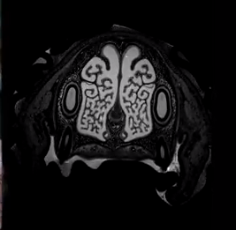
Inside the extraordinary nose of a search-and-rescue dog
https://www.youtube.com/watch?v=FLH36ML8IEU

Slide 28

Dogs Can Smell Cancer - Secret Life of Dogs - BBC
https://www.youtube.com/watch?v=e0UK6kkS0_M

Slide 29
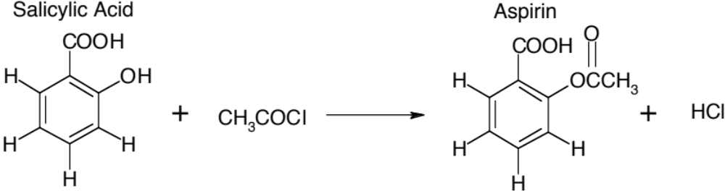
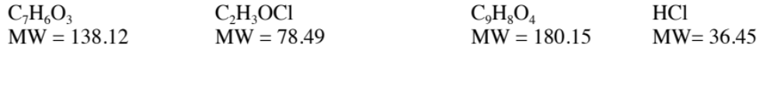
Mass Calculations:
Reactants Products
How many grams of aspirin are theoretically produced from 6.0 g of salicylic acid with an excess of acetyl chloride, C₂H₃OCl?
Balanced Equation:
1
1
1
1

Slide 30
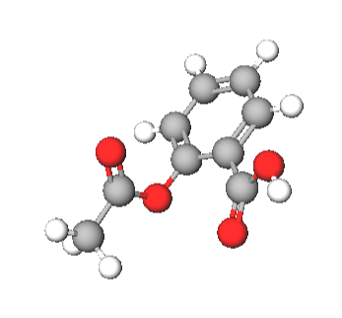
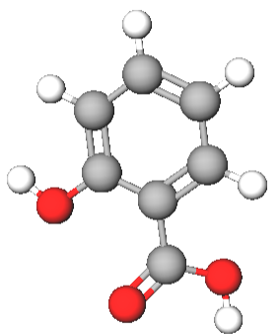
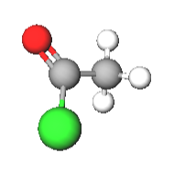

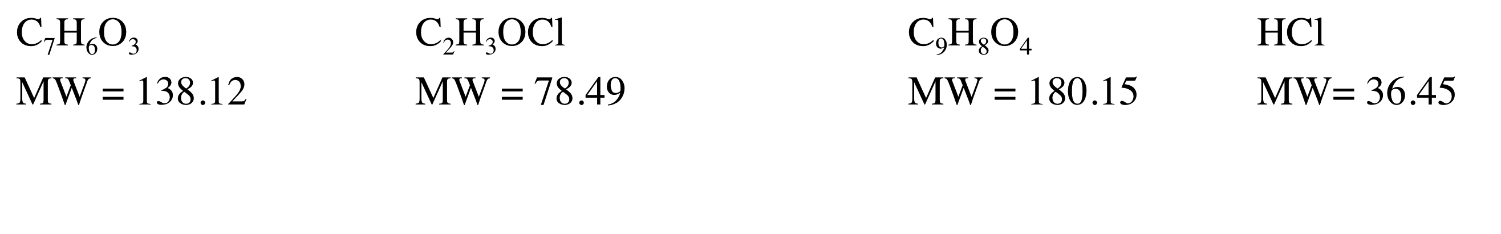
Mass Calculations:
Reactant Product
How many grams of aspirin are theoretically produced from 6.0 g of salicylic acid with an excess of acetyl chloride, C₂H₃OCl?
Balanced Equation:
1
1
1

Slide 31
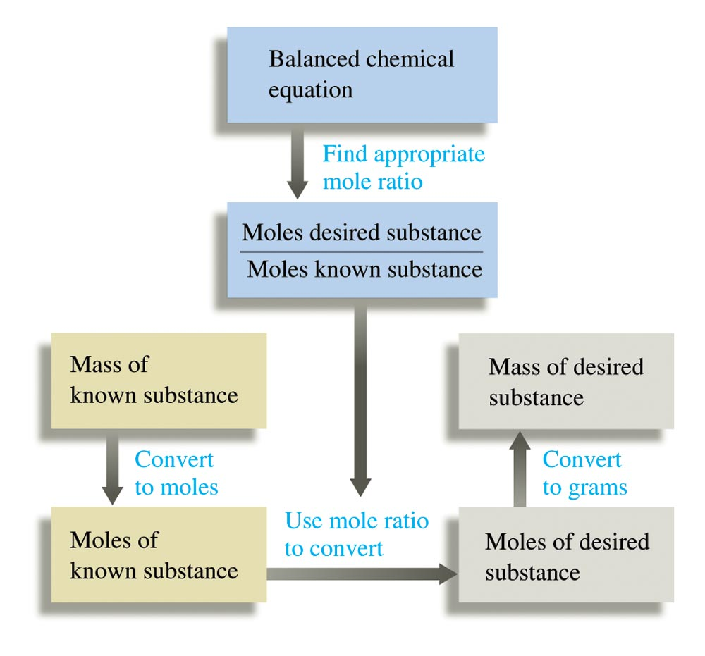
Mass Calculations:
Reactants Products

Slide 32

Theoretical (Yield) Mass Calculations
Reactant Product
grams (Reactant)
grams (Product)
Moles
Molar Mass
Stoichiometry
grams (R)
1 mol (R)
? mol (P)
grams (P)
? grams (P)
? mol (R)
grams (R)
1 mol (P)
(Divide)
Mass (R)
(Multiply)
Mass (P)
by Molar
"Gatekeepers”
from
Balanced reaction
by Molar

Slide 33
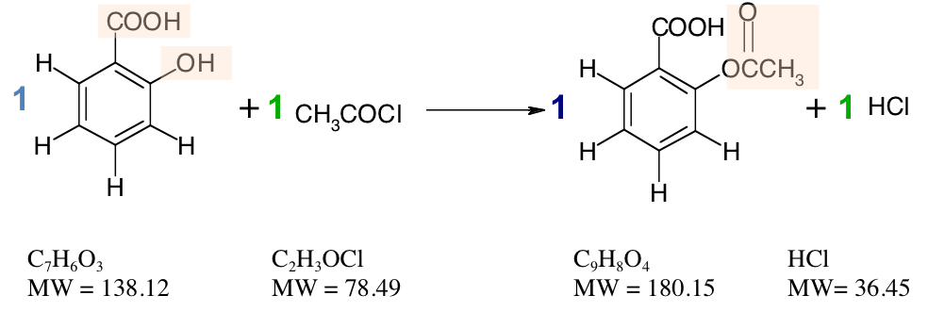
Mass Calculations:
SA
A
grams (Salicylic Acid)
grams (Aspirin)
Moles
Molar Mass
C₉H₈O₄
MW = 180.15
Stoichiometry
grams (A)
(Molecular
6.0 grams (SA)
1 mol (SA)
1 mol A
Weight A)
? (A)
1 mol SA
grams (SA)
1 mol (A)
7.8 g
aspirin
(Molecular
Weight SA)
"Gatekeeper"
C₇H₆O₃
MW = 138.12

Slide 34
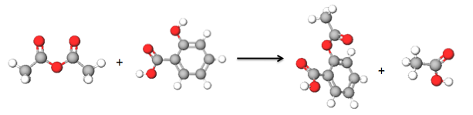
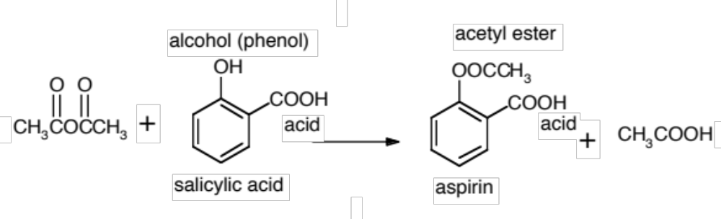
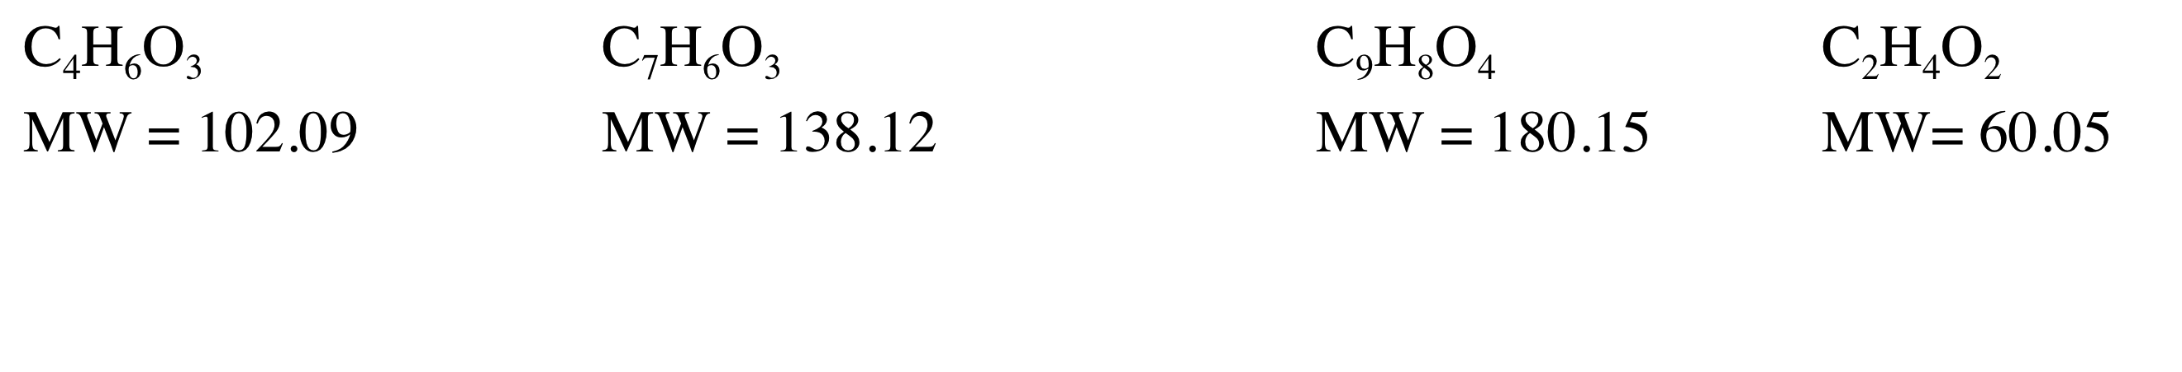
QUESTION
http://chemconnections.org/general/chem108/o-chem%20tutorial/Screen%20Shot%202018-12-07%20at%203.55.53%20PM.png
#7
How many grams of aspirin can be theoretically produced from 5.0 g of salicylic acid reacting with an excess of acetic anhydride, C₄H₆O₃?
Balanced Equation:
A) 3.8 g B) 5.0 g C) 6.5 g D) 7.8 g

Slide 35

Percent Yield
In synthesis as in any experiment, it is very difficult and at most times impossible to be perfect. Therefore the actual yield (g) is measured and compared to the theoretical calculated yield (g). This is the percent yield:
% Yield = actual (g) / theoretical (g) x 100

Slide 36
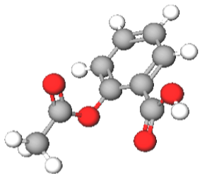
QUESTION
http://chemconnections.org/general/chem108/o-chem%20tutorial/Screen%20Shot%202018-12-07%20at%203.56.16%20PM.png
#8
Kaitlyn’s synthesis of aspirin, C₉H₈O₃, produced 5.90g. The calculated theoretical yield was 6.50g; what is her % yield?
A) 47.5% B) 80.3% C) 90.8% D) 110%

